Slide 1

Ruby

Slide 2
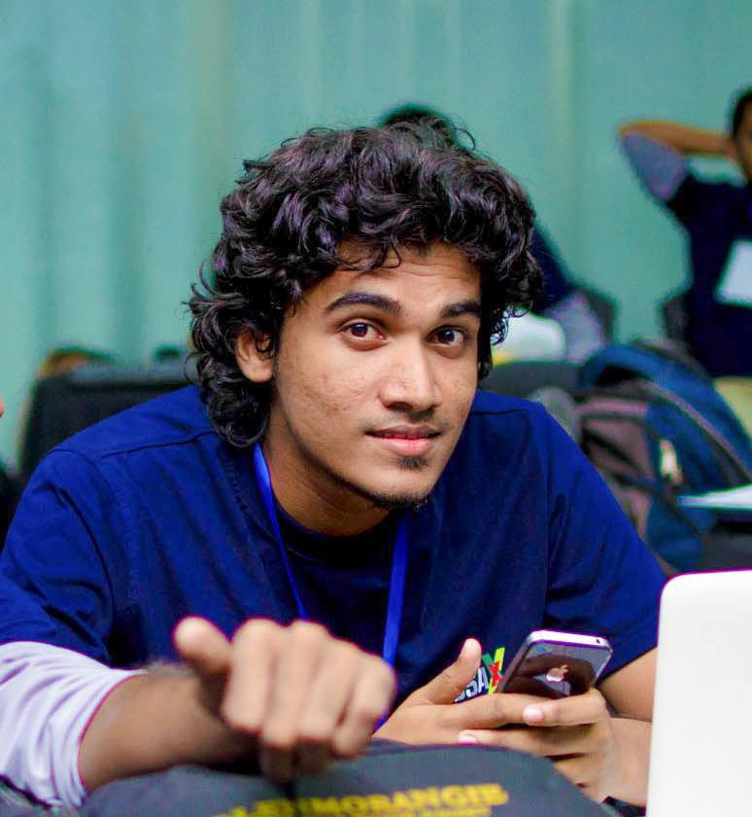



Dilum Navanjana
Senior Software Engineer
99x Technology
DilumN@99x.lk
dilumn_
dilumn

Slide 3


Slide 4
There are numerous programming languages

Slide 5
But what we love most is..

Slide 6
Ruby

Slide 7
But what is Ruby?

Slide 8
Ruby the syntax

Slide 9
Ruby the philosophy

Slide 10
Ruby the library

Slide 11
Ruby the gems

Slide 12
Ruby the community

Slide 13
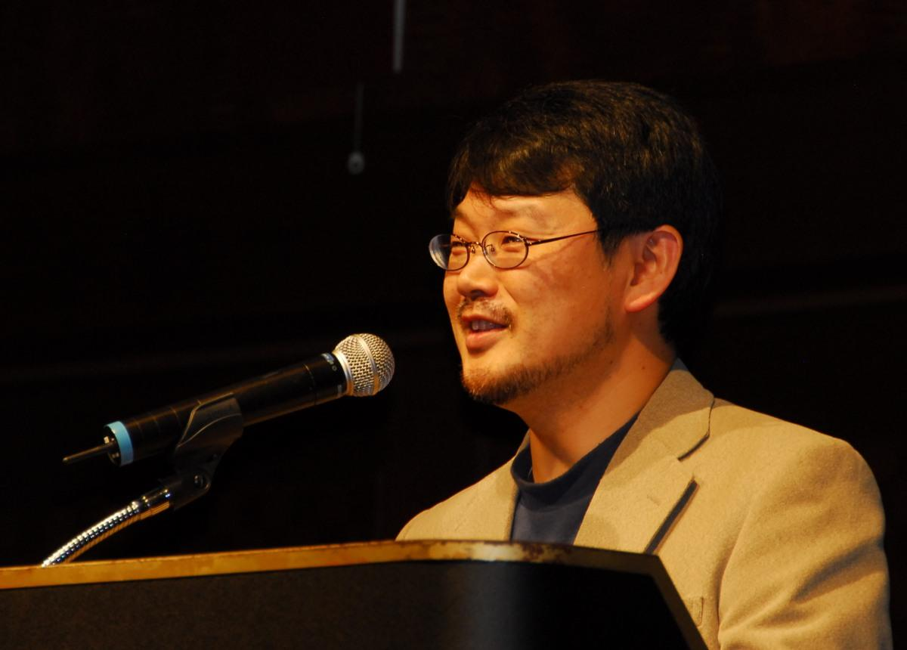
Yukihiro Matsumoto
“Ruby is simple in appearance, but is very complex inside, just like our human body” - Yukihiro Matsumoto

Slide 14
Ruby versions
Ruby MRI
JRuby
goruby
Rubinius

Slide 15
Basic features
Classes, Inheritance
Threads
Cross Platform
Garbage Collection
Exception Handling
Object Oriented
Regular Expressions
Variables are not typed
Powerful string operations

Slide 16
Awesome Ruby
It’s beautiful

Slide 17
It’s beautiful
puts “Hello World”

Slide 18
It’s beautiful
a = 5
b = “HI”

Slide 19
Awesome Ruby
Everything is an object

Slide 20
Everything is an object
a = 5
a.class //Fixnum

Slide 21
Everything is an object
5.times { puts "Hello" }

Slide 22
Awesome Ruby
Duck Typing
If an object walks like a duck and talks like a duck, then the Ruby interpreter is happy to treat it as if it were a duck.

Slide 23
Awesome Ruby
open classes

Slide 24
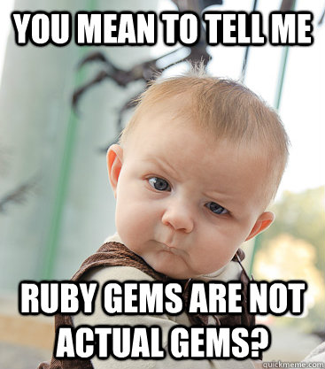
Awesome Ruby
gems

Slide 25
gems
You can create your own gem
bundle gem GEMNAME

Slide 26
Demo

Slide 27
Part II

Slide 28
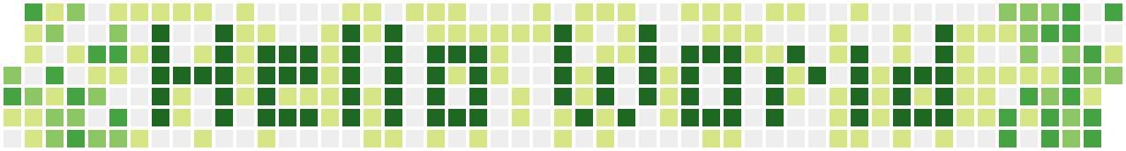

Slide 29
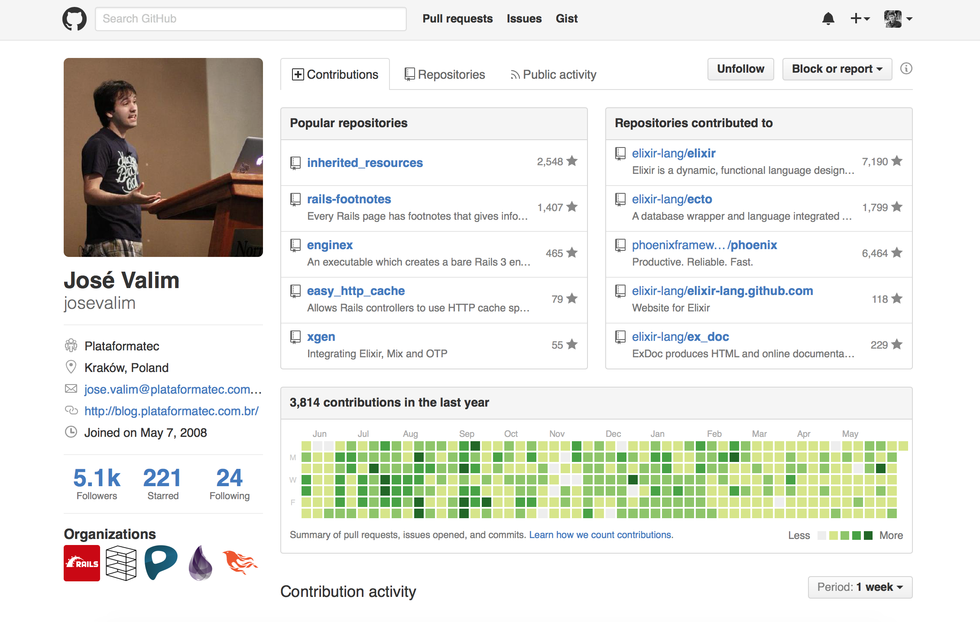

Slide 30
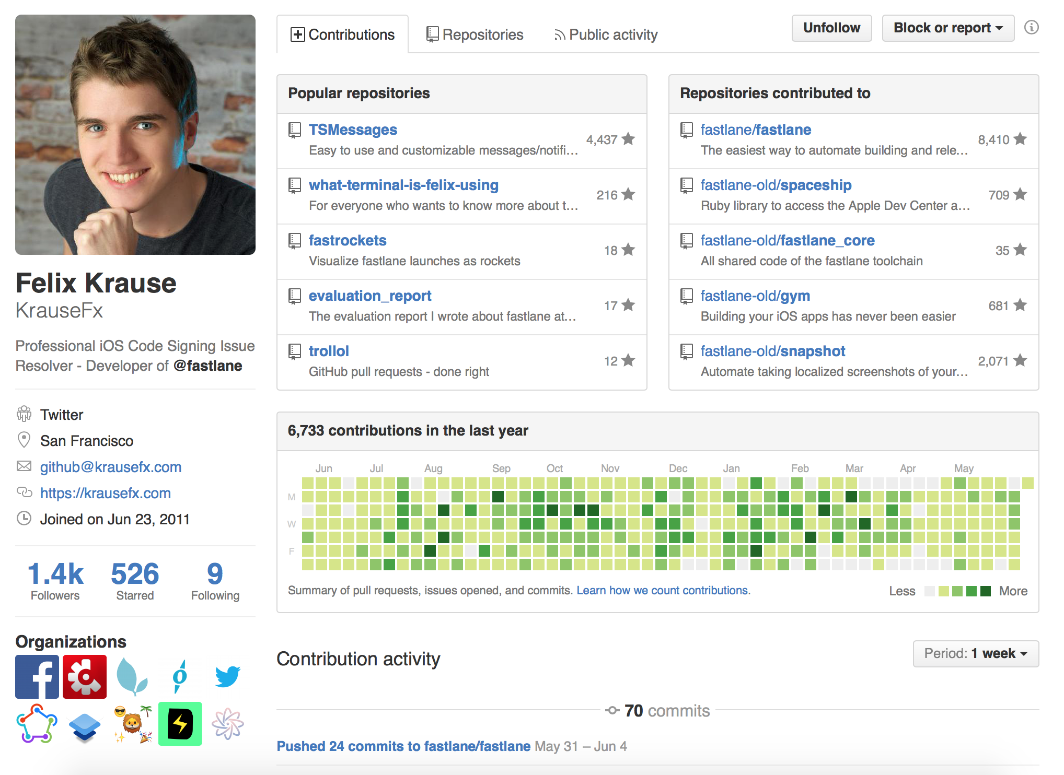

Slide 31
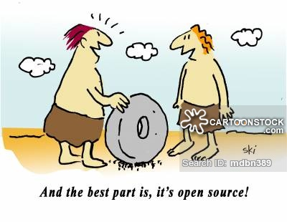
What if we didn’t have Open Source

Slide 32
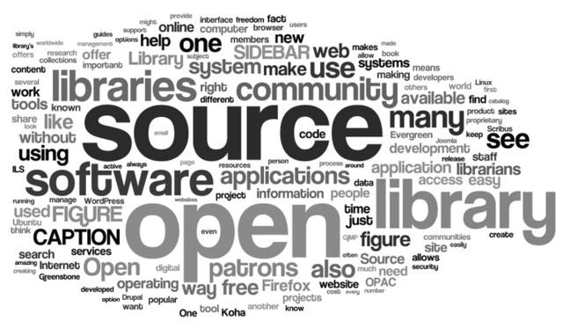
Use Open Source Software

Slide 33
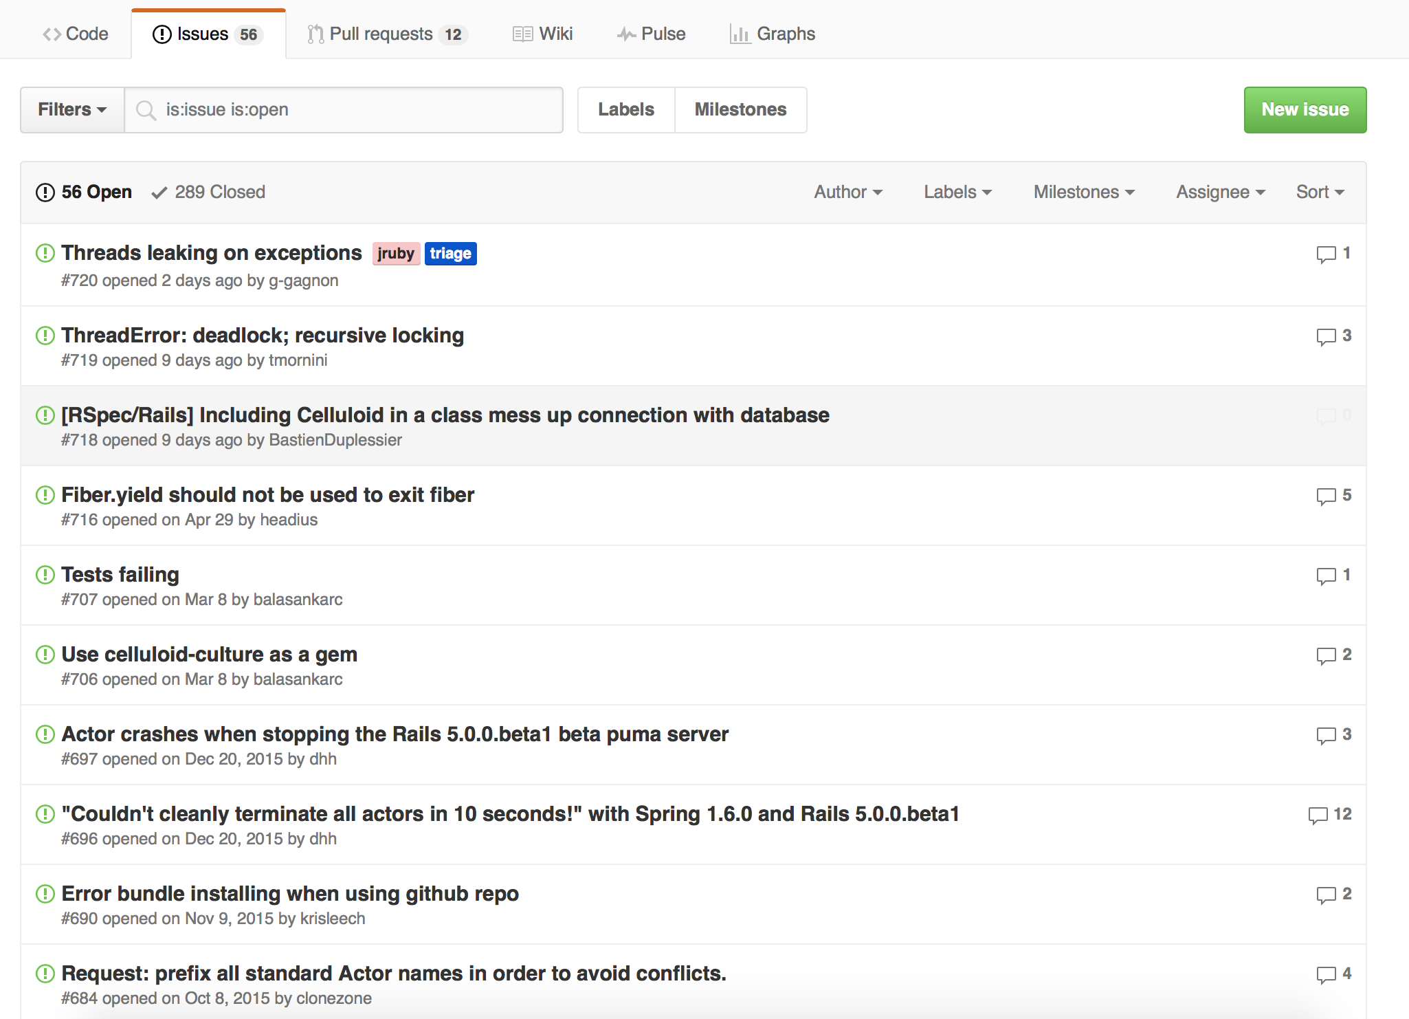
2. Report bugs if you find while using

Slide 34
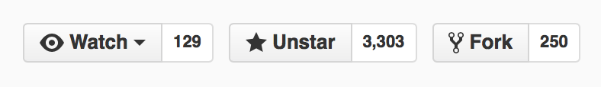
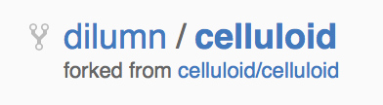
3. Start with small patches to gain confidence
Fork the repository

Slide 35
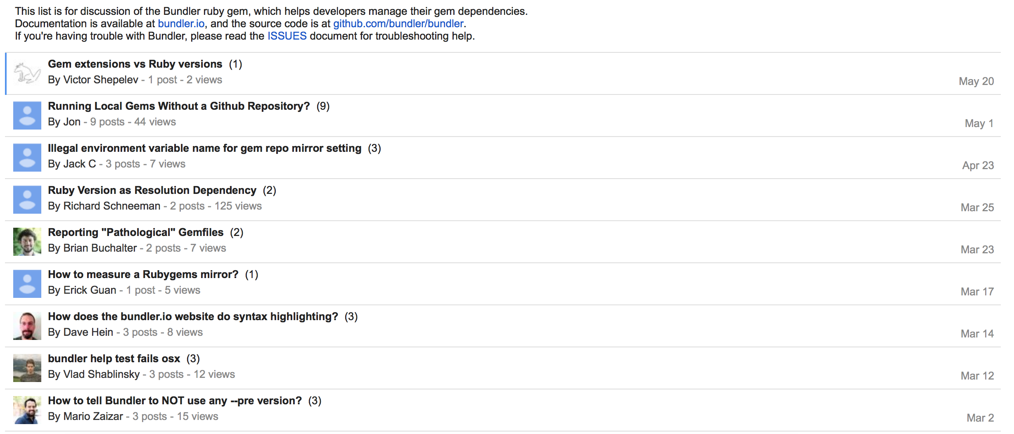
4. Participate in the mailing list / bug reporter to answer questions

Slide 36
5. Make larger patches

Slide 37
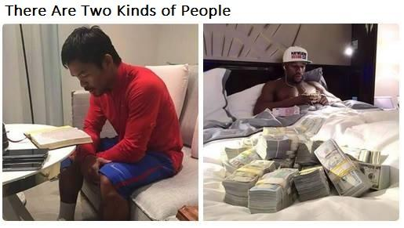
Money matters

Slide 38
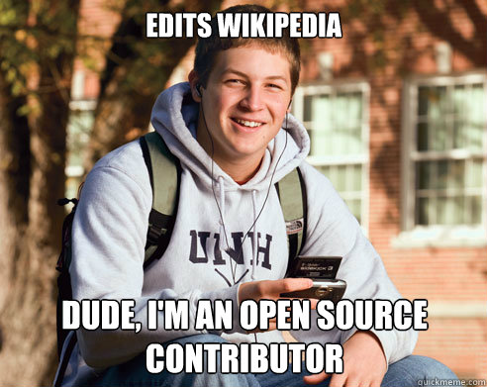
Benefits of become an Open Source Contributor

Slide 39

Google Summer of Code

Slide 40


Slide 41
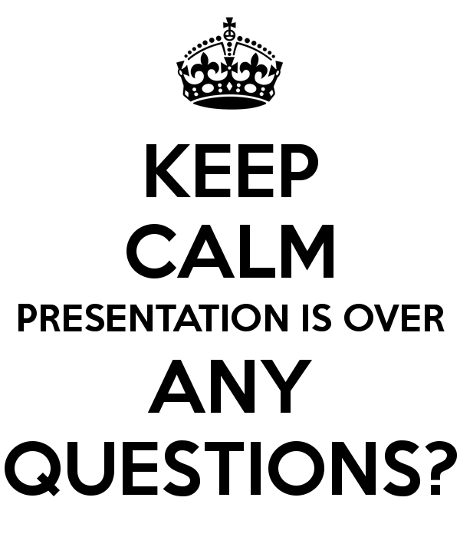

Slide 42
Thank you….
dilumn_

